Slide 1
Year 12 Prepa Talk
October 2020

Slide 2

Es el inicio de sus cursos A Level/AS Level que conforma 2 años de trabajo
No presentan exámenes internacionales este año.
Es muy importante para el ingreso a las universidades el promedio obtenido este año.

Slide 3
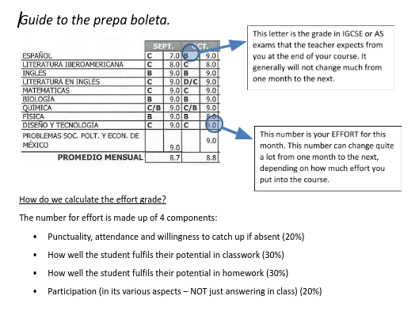
Boletas
+
Assessment
Years 12- 13 once a month

Slide 4
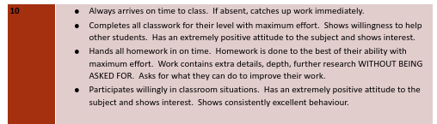

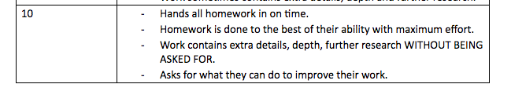
BOLETAS: Grading
How can I avoid low effort grades?
Try to produce work that you consider to be high quality, always push yourself to improve.
Show interest and enthusiasm, ask questions
Try to contribute to the “learning environment” of your whole group.
Plan your time sensibly at home (using your diary)
Avoid copying from other students or directly from source material
Try not to be absent.
Arrive to class on time
Talk to your tutor and/or your teacher if you feel you are having difficulties.

Slide 5
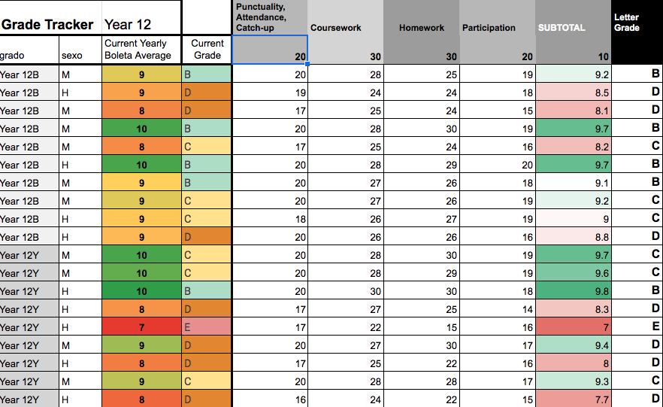

Slide 6
AS Courses - Initial Points
Students will need to complete the majority of these courses in their own time outside of the classroom
Coursework is a part of many of the options though and this is just as important as exams
Teachers will be in touch with these deadlines, they are very important so please look out for them
There will also be mock exams that are important to prepare for properly.
Important to miss as little time as possible from these exam courses in Prepa.
Most students will sit the exams at the end of year 13

Slide 7
AS/A LEVEL Courses
Year 12:
3 or 4 options at AS level + Spanish A level, English, Maths (Mex Uni course, some do additional AS level)
Students may also choose to sit an external Cambridge English as a Second Language qualification (IELTS) in Year 12 or 13, which can count towards their 4 qualifications needed to pass.
They need to achieve a 6.5 on this exam. This exam is only valid for 2 years, but can be a good backup option for those who do not want to sit an English AS level.
Year 13: Most have focussed down to 3 options. They've also decided which of the English courses they want to do (AS level Lang+Lit, AS level English General or IELTS). All students sit Spanish A level.
A typical pathway to achieving 4 AS grades required maybe:
A level Spanish (2 AS grades) + English + AS level in History (or any other option at AS)
For international university applications we would recommend students try and sit 5 or more AS levels or 3 full A levels, if possible

Slide 8
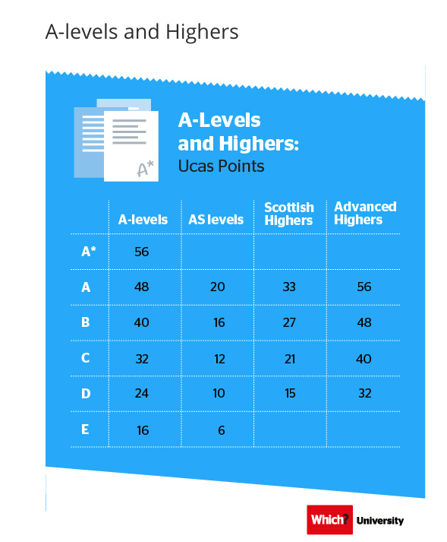

University Applications
International universities vary: some require 3 A levels, some will accept AS levels if they do a foundation course, some will do it on points (such as the image on the side here showing UK university points).
Our University and Careers Team (NW, AC and DG) work with them individually depending which one they want to apply to.
Subject Fit
Applications
Country profiles
For scholarships at Mexican universities, their number ‘boleta’ average in Year 12 is important

Slide 9

Criteria AS and A level
4 AS levels at E or above for UNAM revalidation but we really want to encourage more than this if possible.
University applications
Future jobs
Academic careers
Really should be trying to get as high as possible.

Slide 10

Students may also choose to sit an external Cambridge English as a Second Language qualification (IELTS) in Year 12 or 13, which can count towards their 4 qualifications needed to pass. They need to achieve a level 6.5 in this exam. This exam is only valid for 2 years, but can be a good backup option for those who do not want to sit an English AS Level. The English Department will assess whether this is a good option for your child.

Slide 11
Revalidación
2°de Preparatoria - Revalidación con calificaciones expedidas por VICTORIA, incluyendo la calificación aprobatoria de la asignatura de contenido nacional.
3°de Preparatoria - Revalidación con exámenes AS/A incluyendo la calificación aprobatoria de la asignaturas de contenido nacional.

Slide 12







Becas

